Slide 1
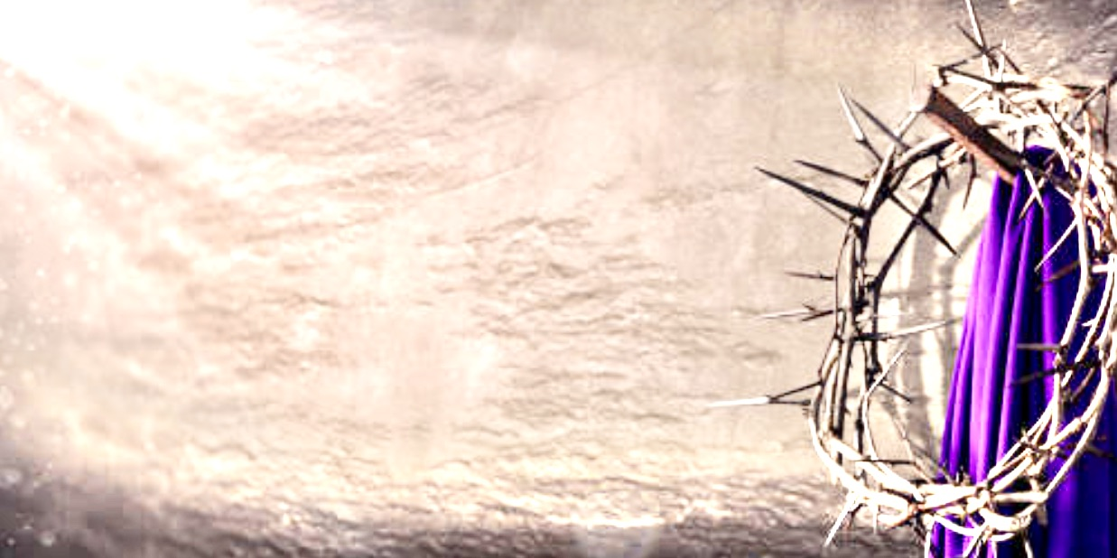
爱是不保留
Unreserved Love
曲/词：by 卢永亨 / Juwita Suwito

Slide 2
常听说世界 爱没长久,
哪里会有爱无尽头?
尘俗的爱只在乎曾拥有,
一刻灿烂 便要走!
I’ve been told love won’t survive; promises
will turn into lies. The world thinks love is
just possession, it comes and goes.
爱是不保留 1/4

Slide 3
而我却确信 爱是恒久,
碰上了您已无别求;
无从解释不可说明的爱,
千秋过后仍长存不朽!
I believe everlasting Love after I met You.
Your unfailing love is not comprehensible
Your Love endures for generations
爱是不保留 2/4

Slide 4
谁人受痛苦被悬挂在木头?
至高的爱尽见于刺穿的手;
看! 血在流反映爱没保留,
持续不死的爱 到万世不休!
You died on the Cross and suffered for my sins,
Your pierced bleeding hands have
shown Your unreserved, unending Love.
爱是不保留 3/4

Slide 5
惟求奉上生命全归主所有,
要将一切尽献于我主的手;
我已决定今生再没所求,
惟望得主称赞已足够!
Lord, make my life an offering, help me to serve
You with all my heart. I have no other purpose
in life, but to worship and praise You
爱是不保留 4/4

Slide 6
我却确信爱是恒久,
碰上了您已无别求;
无从解释不可说明的爱,
千秋过后仍长存不朽!
I believe everlasting Love after I met You.
Your unfailing love is not comprehensible
Your Love endures for generations
爱是不保留 2/4

Slide 7
谁人受痛苦被悬挂在木头?
至高的爱尽见于刺穿的手;
看!血在流反映爱没保留,
持续不死的爱到万世不休!
You died on the Cross and suffered for my sins,
Your pierced bleeding hands have
shown Your unreserved, unending Love.
爱是不保留 3/4

Slide 8
惟求奉上生命全归主所有,
要将一切尽献于我主的手;
我已决定今生再没所求,
惟望得主称赞已足够!
Lord, make my life an offering, help me to serve
You with all my heart. I have no other purpose
in life, but to worship and praise You
爱是不保留 4/4

Slide 9
惟求奉上生命全归主所有,
要将一切尽献于我主的手;
我已决定今生再没所求,
惟望得主称赞已足够!
Lord, make my life an offering, help me to serve
You with all my heart. I have no other purpose
in life, but to worship and praise You
爱是不保留 4/4

Slide 10
我已决定今生再没所求,
惟望得主称赞已足够!
I have no other purpose in life,
but to worship and praise You
爱是不保留 4/4

